Slide 1
Orthogonality
Hung-yi Lee

Slide 2
Outline
Reference: Chapter 7.1

Slide 3

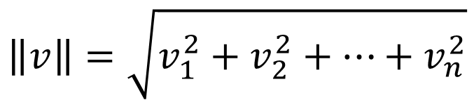

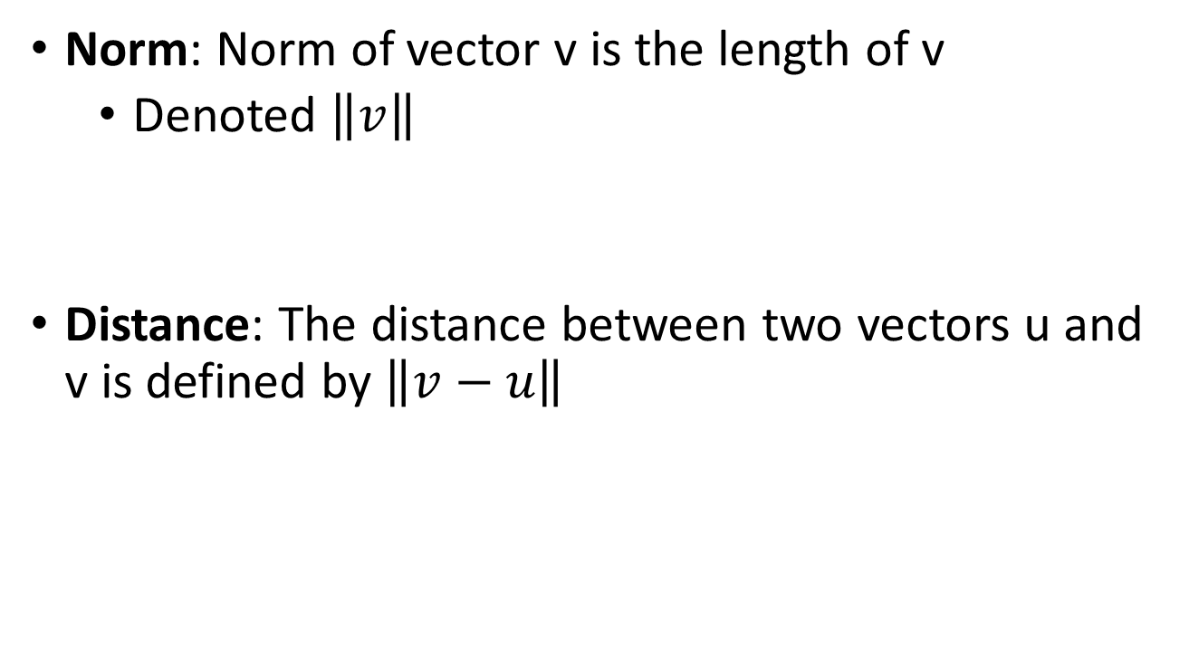





Norm & Distance
Norm: Norm of vector v is the length of v
Denoted $\left\|v\right\|$
Distance: The distance between two vectors u and v is defined by $\left\|v−u\right\|$
$$\left\|v\right\|=\sqrt{v_{1}^{2}+v_{2}^{2}+⋯+v_{n}^{2}}$$
$$\left\|v\right\|=\sqrt{1^{2}+2^{2}+3^{2}}$$
$$=\sqrt{14}$$
$$v=\left[\begin{aligned}1 \\ 2 \\ 3\end{aligned}\right]$$
$$u=\left[\begin{aligned}2 \\ −3 \\ 0\end{aligned}\right]$$
$$v−u=\left[\begin{aligned}−1 \\ 5 \\ 3\end{aligned}\right]$$
$$\left\|v−u\right\|=\sqrt{{\left(−1\right)}^{2}+5^{2}+3^{2}}$$
$$=\sqrt{35}$$

Slide 4


Orthogonal
https://www.youtube.com/watch?v=43BfcSkctYA
https://www.youtube.com/watch?v=EktZVposDMU

Slide 5
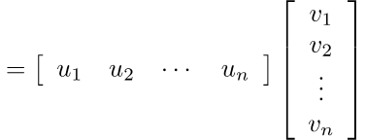


Dot Product & Orthogonal
Dot product: dot product of u and v is
Orthogonal: u and v are orthogonal if $u∙v=0$
$$u∙v=u_{1}v_{1}+u_{2}v_{2}+⋯+u_{n}v_{n}$$
$$=u^{T}v$$
Orthogonal is actually “perpendicular”
Zero vector is orthogonal to every vector

Slide 6
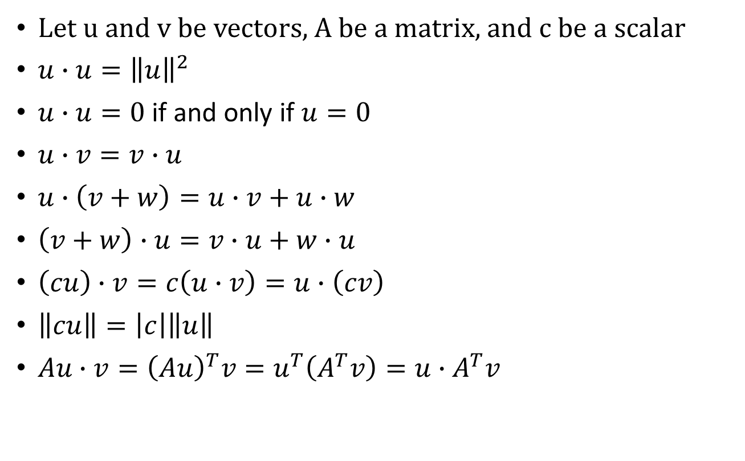
More about Dot Product
Let u and v be vectors, A be a matrix, and c be a scalar
$u∙u={\left\|u\right\|}^{2}$
$u∙u=0$ if and only if $u=0$
$u∙v=v∙u$
$u∙\left(v+w\right)=u∙v+u∙w$
$\left(v+w\right)∙u=v∙u+w∙u$
$\left(cu\right)∙v=c\left(u∙v\right)=u∙\left(cv\right)$
$\left\|cu\right\|=\left|c\right|\left\|u\right\|$
$Au∙v={\left(Au\right)}^{T}v=u^{T}\left(A^{T}v\right)=u∙A^{T}v$
Connect norm and dot product
Example
……

Slide 7
Example
……

Slide 8

Pythagorean Theorem
=0 if and only if u and v are orthogonal
Proof:
Notes:
geometric condition for perpendicularity
畫個圖說明一下 下面那個
Pythagorean
paiˋθægəriən]
畢達哥拉斯的
Rhombus 靈行

Slide 9



Pythagorean Theorem
The diagonals of a parallelogram are orthogonal.
The parallelogram is a rhombus.
Proof:
$$\left(u+v\right)∙\left(u−v\right)$$
$$=0$$
||u|| = ||v||
$$={\left\|u\right\|}^{2}−{\left\|v\right\|}^{2}$$

Slide 10






Triangle Inequality
For any vectors u and v,
Proof:
$${\left\|u+v\right\|}^{2}$$
$$={\left\|u\right\|}^{2}+2u∙v+{\left\|v\right\|}^{2}$$
$$≤{\left\|u\right\|}^{2}+2|u∙v|+{\left\|v\right\|}^{2}$$
Cauchy-Schwarz Inequality
$$≤{\left\|u\right\|}^{2}+2\left\|u\right\|∙\left\|v\right\|+{\left\|v\right\|}^{2}$$
$$≤{\left(\left\|u\right\|+\left\|v\right\|\right)}^{2}$$

